Slide 1
Data Structures and Algorithms (ESO207)
Lecture 36
A new algorithm design paradigm:
part III
Greedy strategy

Slide 2
Continuing Problem from last class
Minimum spanning tree

Slide 3
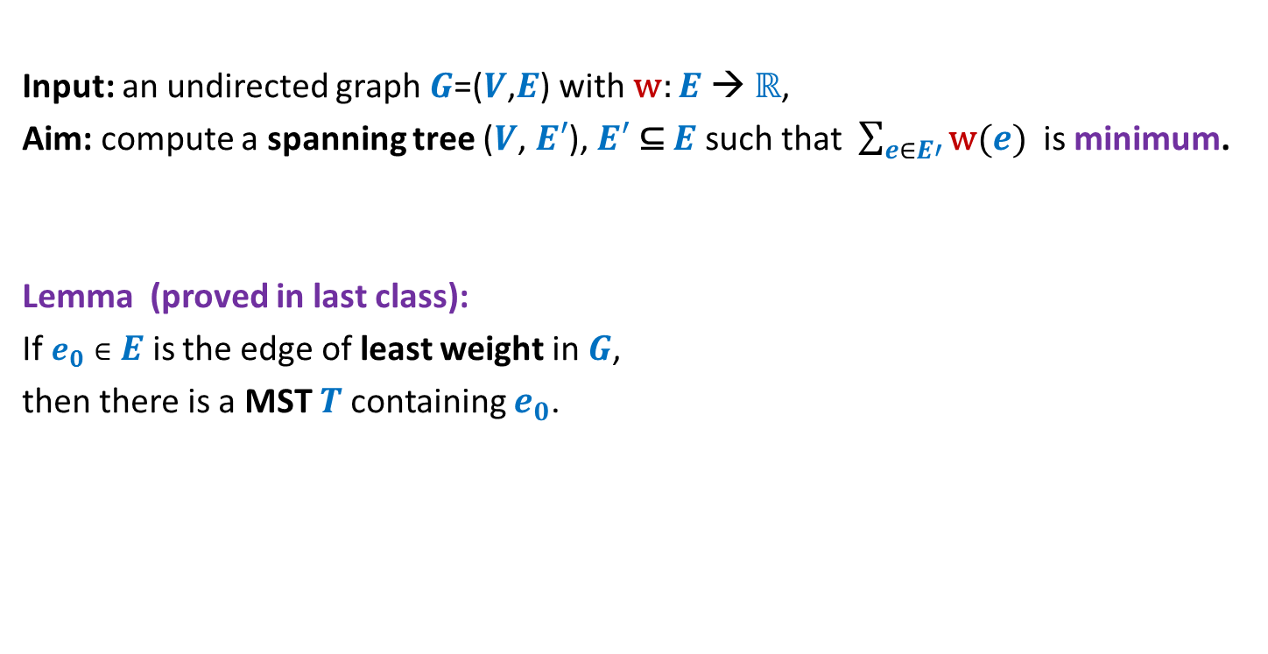
Problem Description
Input: an undirected graph $G$=($V$,$E$) with w: $E$ → ℝ,
Aim: compute a spanning tree ($V$, $E′$), $E′$ ⊆ $E$ such that $\sum_{e∈E′}{\text{w}(e)}$ is minimum.
Lemma (proved in last class):
If $e_{0}∈E$ is the edge of least weight in $G$,
then there is a MST $T$containing $e_{0}$.
How to use this Lemma to design an algorithm for MST ?

Slide 4

Minimum Spanning Tree (MST)
170
24
33
63
$$e_{0}$$
70
35
50
70
13
41
81
64
78
53
42
52
80
49
54
42
60
44
43
50
30
49
57
29
102

Slide 5
Minimum Spanning Tree (MST)
170
24
33
63
70
35
50
70
13
41
81
64
78
53
42
52
80
49
54
42
60
44
43
50
30
49
57
29
102

Slide 6


Minimum Spanning Tree (MST)
Theorem:
w(MST($G$)) = w(MST($G′$)) + w ($e_{0}$)
170
24
33
63
70
50
70
41
81
$$G′$$
64
78
49
53
52
80
54
42
60
44
43
50
30
49
57
29
102

Slide 7
Minimum Spanning Tree (MST)
170
w
24
33
v
63
70
35
50
x
13
70
41
81
64
78
53
u
y
42
52
80
49
54
42
60
44
43
50
30
49
57
29
102

Slide 8
A useful lesson for design of a graph algorithm
If you have a complicated algorithm for a graph problem, …
search for some graph theoretic property
to design simpler and more efficient algorithm

Slide 9
Two graph theoretic properties of MST
Cut property
Cycle property
Every algorithm till date is based on one of these properties!

Slide 10
Cut Property

Slide 11

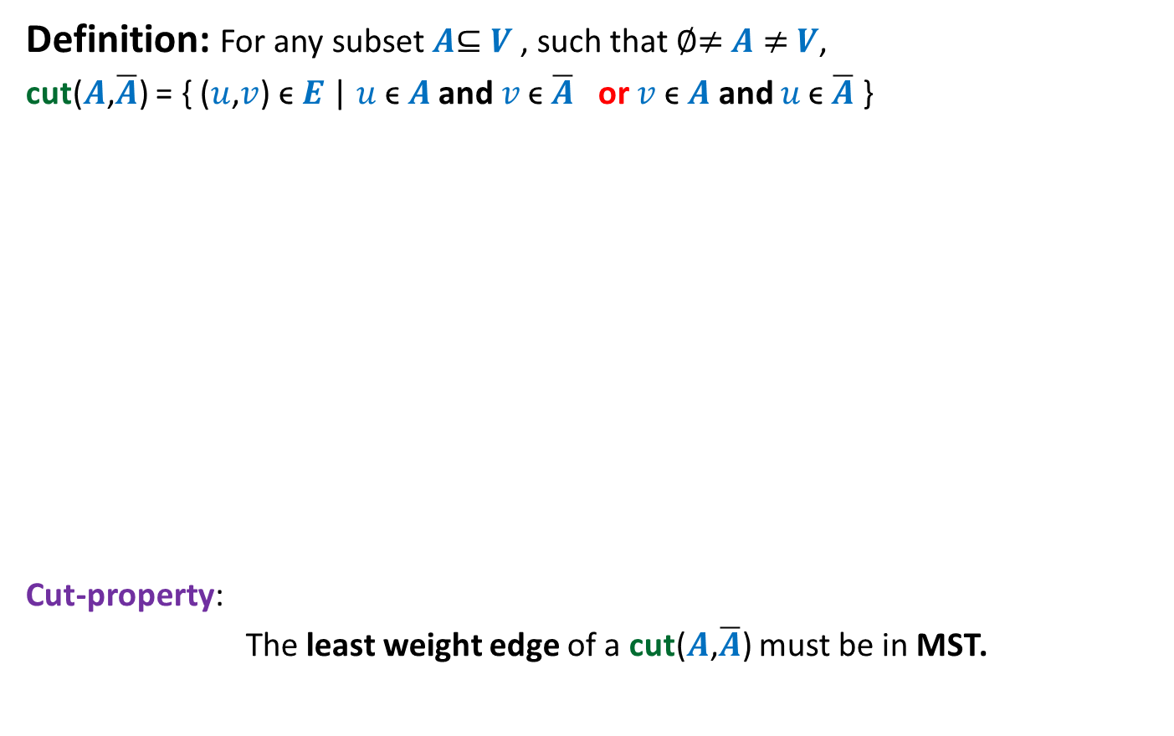
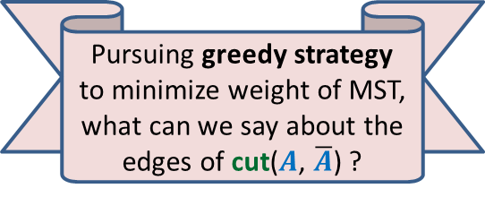


Cut Property
Definition: For any subset $A$⊆ $V$, such that ∅≠ $A$ ≠ $V$,
cut($A$,$\overline{A}$) = { ($u$,$v$) ϵ $E$ | $u \text{ϵ} A$ and $v \text{ϵ} \overline{A}$ or $v \text{ϵ} A$ and $u \text{ϵ} \overline{A}$ }
Cut-property:
The least weight edge of a cut($A$,$\overline{A}$) must be in MST.
Pursuing greedy strategy to minimize weight of MST, what can we say about the edges of cut($A$, $\overline{A}$) ?
$$A$$
cut($A$,$\overline{A}$)
$$\overline{A}$$
48
67
37
v
13
u
23

Slide 12

Proof of cut-property
$$A$$
$$\overline{A}$$
48
67
37
v
13
u
23

Slide 13







Proof of cut-property
Let $T$ be the MST, and (u,v) $∉T$.
Question: What happens if we remove (x,y) from $T$, and add (u,v) to $T$.
$$\text{ϵ} \overline{A}$$
y
x
>13
$$\text{ϵ} A$$
$$\text{ϵ} A$$
v
13
$$\text{ϵ} \overline{A}$$
$$\text{ϵ} A$$
u
$$\text{ϵ} A$$

Slide 14

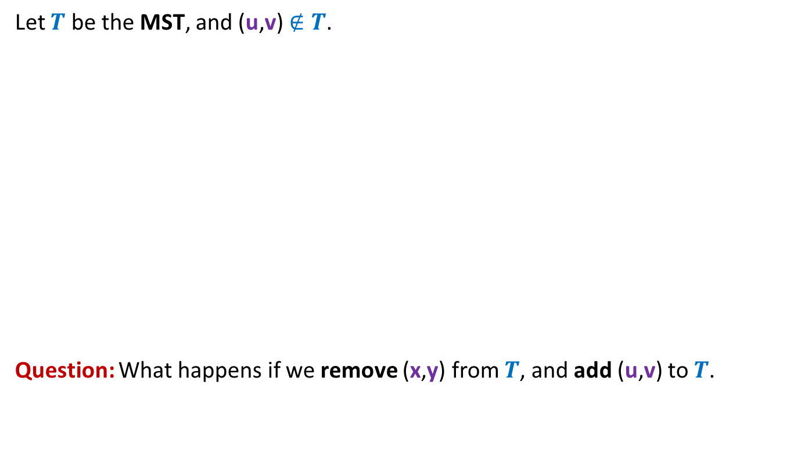
Proof of cut-property
Let $T$ be the MST, and (u,v) $∉T$.
Question: What happens if we remove (x,y) from $T$, and add (u,v) to $T$.
y
x
≥13
v
13
u
We get a spanning tree $T′$ with weight < weight($T$)
A contradiction !

Slide 15
Cycle Property

Slide 16


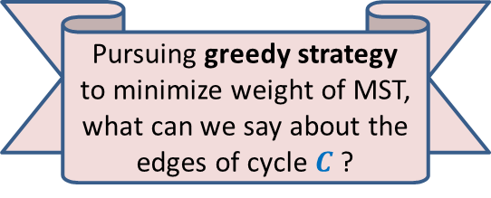
Cycle Property
c
b
31
Let $C$ be any cycle in $G$.
Cycle-property:
Maximum weight edge of any cycle $C$can not be present in MST.
17
12
f
36
a
s
26
Pursuing greedy strategy to minimize weight of MST, what can we say about the edges of cycle $C$?
24
43
19
r
u
v
$$C$$

Slide 17


Proof of Cycle property
c
b
31
Let $T$ be the MST, and (u,v) $ϵ T$.
17
12
f
36
a
s
26
24
43
19
r
u
v
$$C$$
43
u
v
$$T$$

Slide 18

Proof of Cycle property
c
b
31
Let $T$ be the MST, and (u,v) $ϵ T$.
17
12
f
36
a
s
26
24
43
19
r
u
v
$$C$$
a
24
43
u
v
12
$$T$$
s
17
c
b
31
f
36

Slide 19

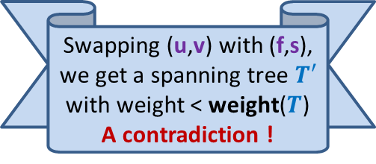
Proof of Cycle property
c
b
31
Let $T$ be the MST, and (u,v) $ϵ T$.
17
12
f
36
a
s
26
24
43
19
r
u
v
$$C$$
Swapping (u,v) with (f,s), we get a spanning tree $T′$ with weight < weight($T$)
A contradiction !
43
u
v
$$T$$
s
f
36

Slide 20
Algorithms based on cut Property

Slide 21
How to use cut property to compute a MST ?
170
24
33
v
63
70
35
50
70
31
41
81
64
78
53
u
42
52
80
49
54
42
60
44
43
50
30
49
57
29
102

Slide 22
How to use cut property to compute a MST ?
170
w
24
33
v
63
70
35
50
70
31
41
81
64
78
53
u
42
52
80
49
54
42
60
44
43
50
30
49
57
29
102

Slide 23
How to use cut property to compute a MST ?
170
w
24
33
v
63
70
35
50
x
31
70
41
81
64
78
53
u
42
52
80
49
54
42
60
44
43
50
30
49
57
29
102

Slide 24
How to use cut property to compute a MST ?
170
w
24
33
v
63
70
35
50
x
31
70
41
81
64
78
53
u
y
42
52
80
49
54
42
60
44
43
50
30
49
57
29
102

Slide 25
How to use cut property to compute a MST ?
170
w
24
33
v
63
70
35
50
x
31
70
41
81
64
78
53
u
y
42
52
80
49
54
42
60
44
43
50
30
49
57
29
102

Slide 26
How to use cut property to compute a MST ?
170
w
24
33
v
63
70
35
50
x
31
70
41
81
64
78
53
u
y
42
52
80
49
54
42
60
44
43
50
30
49
57
29
102

Slide 27

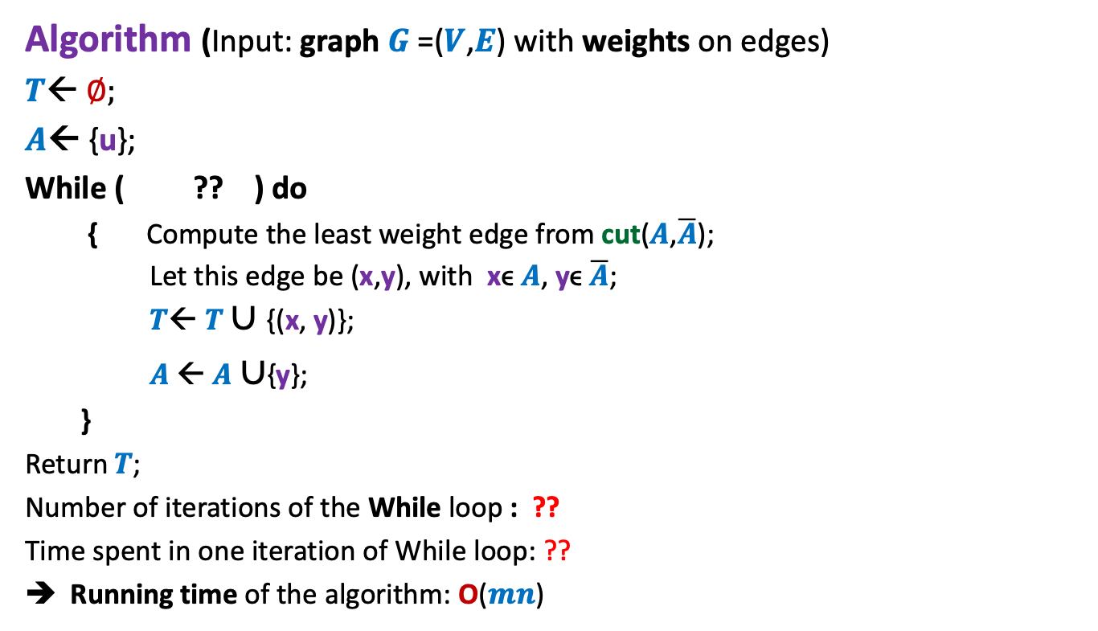


An Algorithm based on cut property (Prim’s Algorithm)
Algorithm (Input: graph $G$=($V$,$E$) with weights on edges)
$T$← ∅;
$A$← {u};
While ( ?? ) do
{ Compute the least weight edge from cut($A$,$\overline{A}$);
Let this edge be (x,y), with xϵ $A$, yϵ $\overline{A}$;
$T$← $T∪${(x, y)};
$A$← $A$ $∪${y};
}
Return$T$;
Number of iterations of the While loop : ??
Time spent in one iteration of While loop: ??
Running time of the algorithm: O($mn$)
$A<>$ $V$
$$n−1$$
$$\text{O}\text{(}m\text{)}$$

Slide 28
Algorithm based on cycle Property

Slide 29

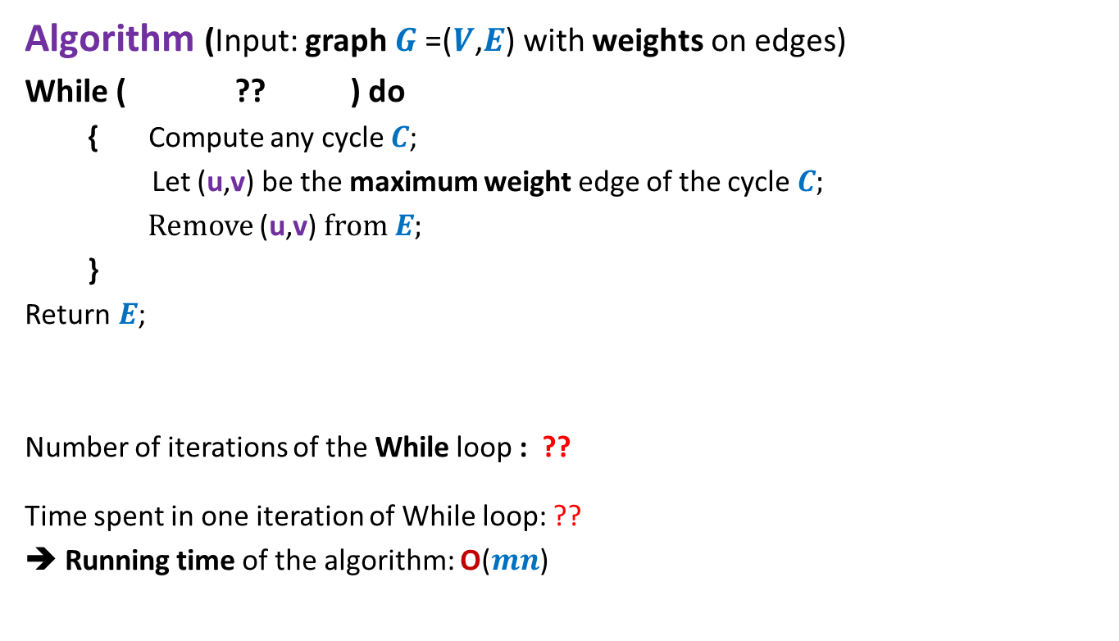


An Algorithm based on cycle property (Kruskal’s Algorithm)
Algorithm (Input: graph $G$=($V$,$E$) with weights on edges)
While ( ?? ) do
{ Compute any cycle $C$;
Let (u,v) be the maximum weight edge of the cycle $C$;
Remove (u,v) from $E$;
}
Return$E$;
Number of iterations of the While loop : ??
Time spent in one iteration of While loop: ??
➔ Running time of the algorithm: O($mn$)
$E$has any cycle
$$m−n+1$$
$$\text{O}\text{(}n\text{)}$$

Slide 30
Problem 3
Mobile towers on a road

Slide 31


Mobile towers on a road
A mobile tower can cover any cell phone within radius $d$.
$$d$$
Mobile tower

Slide 32



Mobile towers on a road
$$d$$
$$d$$
Problem statement:
There are $n$ houses located along a road.
We want to place mobile towers such that
Each house is covered by at least one mobile tower.
The number of mobile towers used is least possible.

Slide 33


Mobile towers on a road
$$d$$
$$d$$
Strategy 1:
Place tower at first house,
Remove all houses covered by this tower.
Proceed to the next uncovered house …
$$d$$
$$d$$

Slide 34

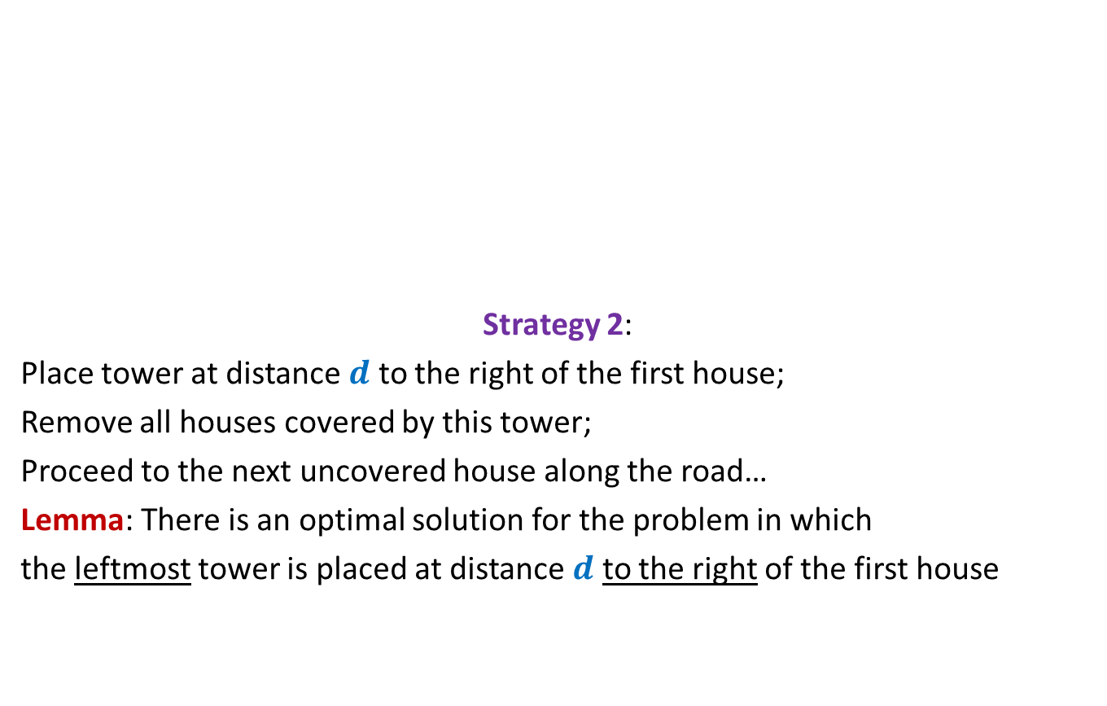

Mobile towers on a road
$$d$$
$$d$$
Strategy 2:
Place tower at distance $d$ to the right of the first house;
Remove all houses covered by this tower;
Proceed to the next uncovered house along the road…
Lemma: There is an optimal solution for the problem in which
the leftmost tower is placed at distance $d$ to the right of the first house
$$d$$
$$d$$
can we say anything about the optimal solution ?

Slide 35

Homework …
Ponder over the following questions before coming for the next class
Use cycle property and/or cut property to design a new algorithm for MST
Use some data structure to improve the running time of the algorithms discussed in this class to O($m log n$)

